Slide 1
Real-Time Dashboards
Chris Lambert, ITS

Slide 2
Snow and Ice Goals
Publish Accurate, Timely, and Relevant Information
Provide Real-Time Fleet Management
Visualize 12-16 Hours of Rolling Data
Provide an Unlimited “Roll Back” or “Replay” Feature
What did we know?
When did we know it?
What was our response?
What was the outcome of our response?
Automate Record Keeping
Develop and Track Performance Based on Historic Analysis

Slide 3
Data Sources
HERE Traffic Speeds
Google/Waze
Incidents
Traffic Jams
Traffic Viewer
Trip
iCones Traffic Speeds
Digital Short Range Communications
CoCoRahs
Doppler Radar
KYTC Snow Plows
KYTC County Activities
KYTC Dynamic Message Signs
KYTC Twitter
Notes:
1) This project is the tip of the spear for organizing the Cabinet’s real-time data.
2) This group has been tasked with combining all real-time information into a single location where that data can be researched and reported on.
3) Why do we need all of this information? Because without it, you’re just guessing about what happens on our roadways. As you can see, KYTC is contributing much less to our understanding of roadway activities.

Slide 4
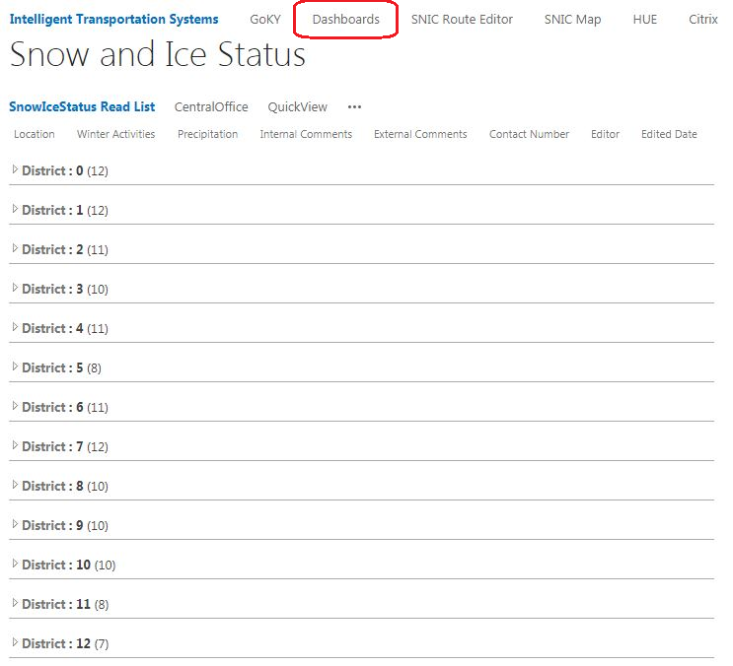
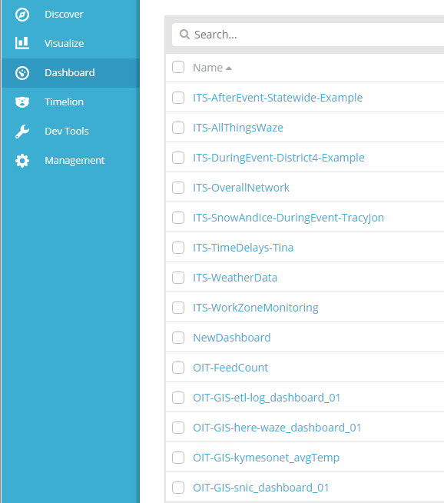
Dashboard Location

Slide 5
First: Check the Timeline

Slide 6
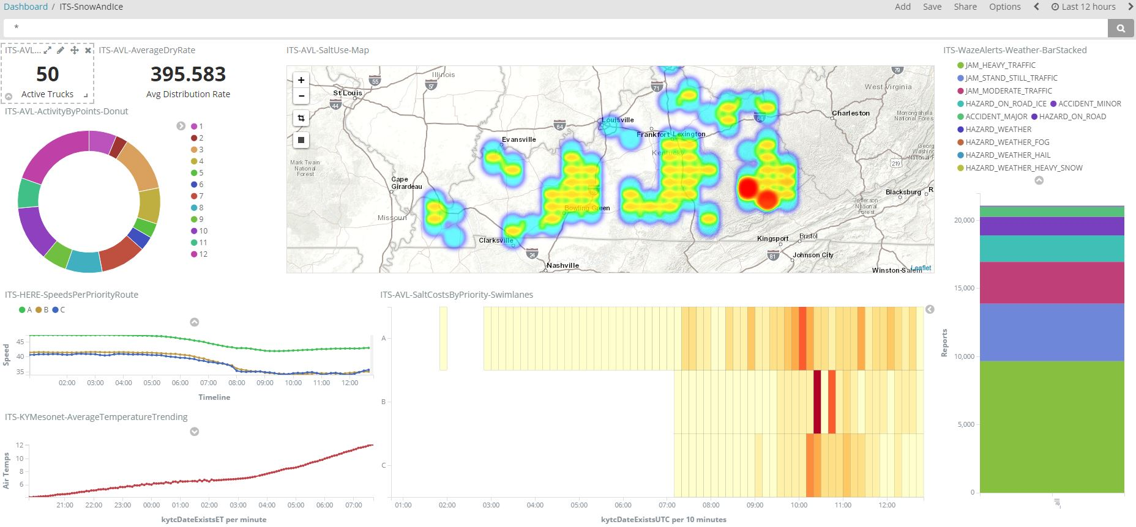

Slide 7
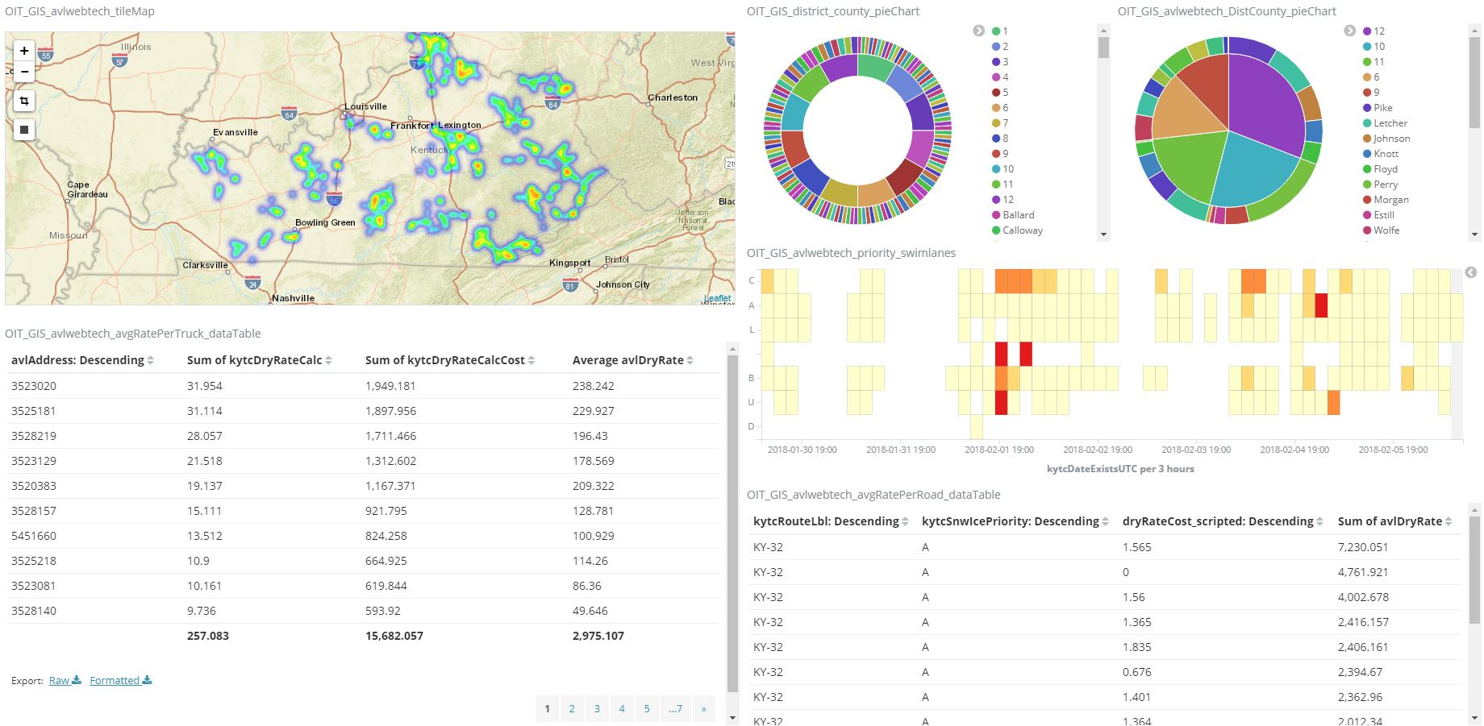

Slide 8
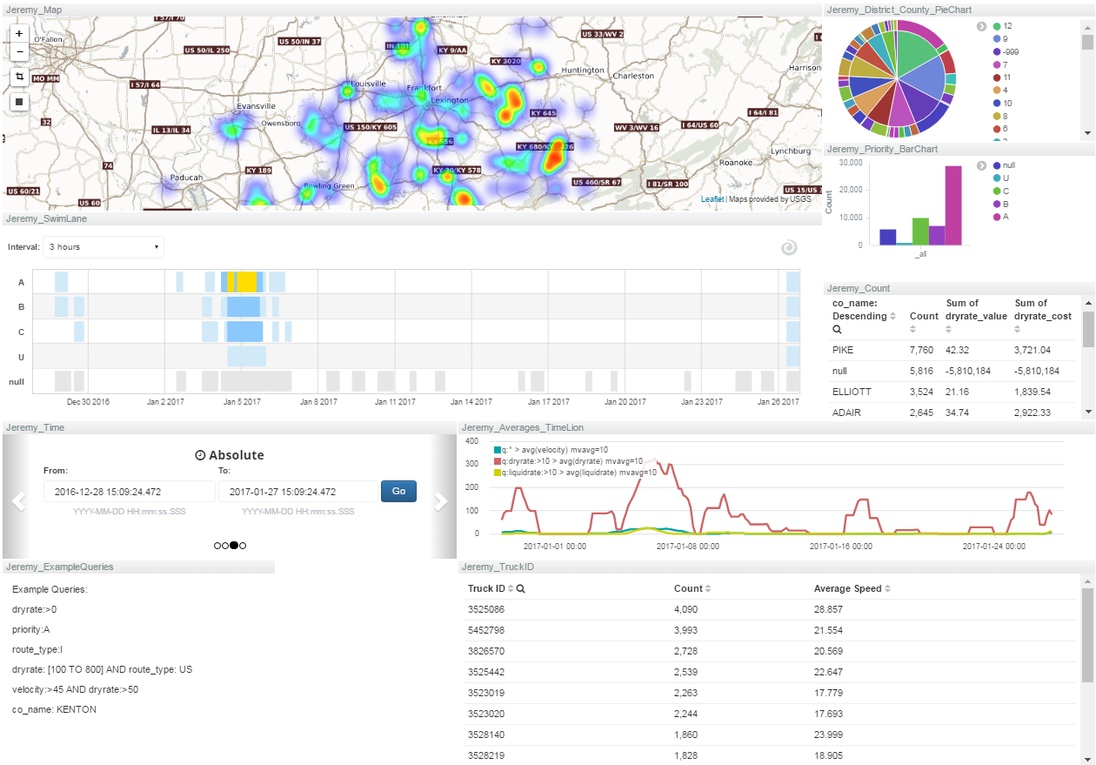

Slide 9
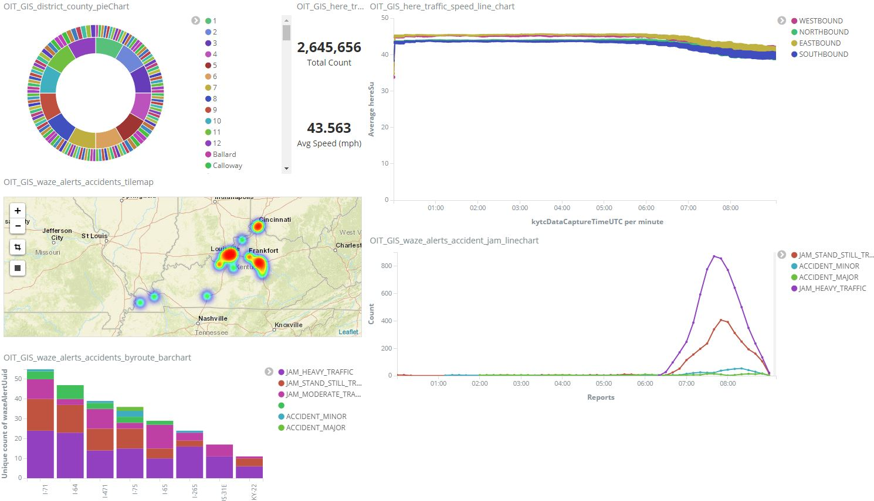

Slide 10
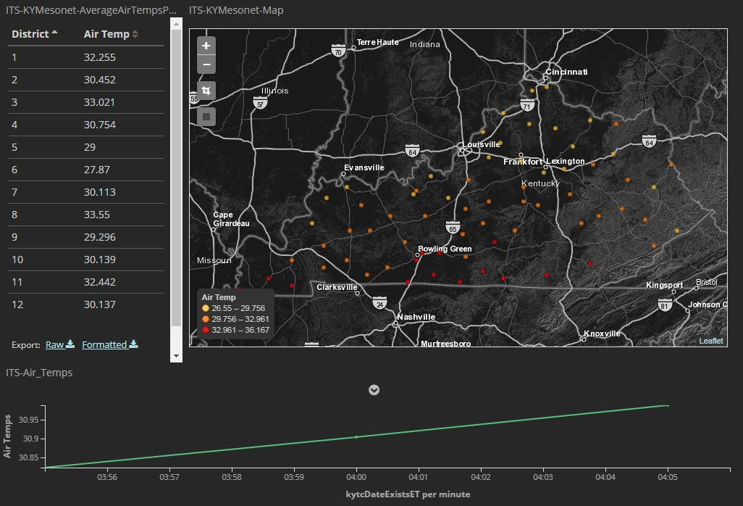

Slide 11
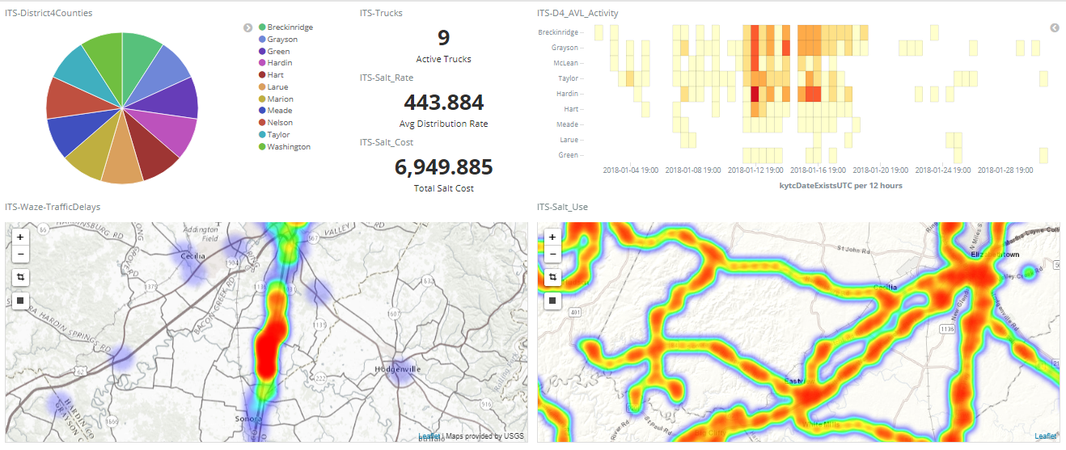

Slide 12
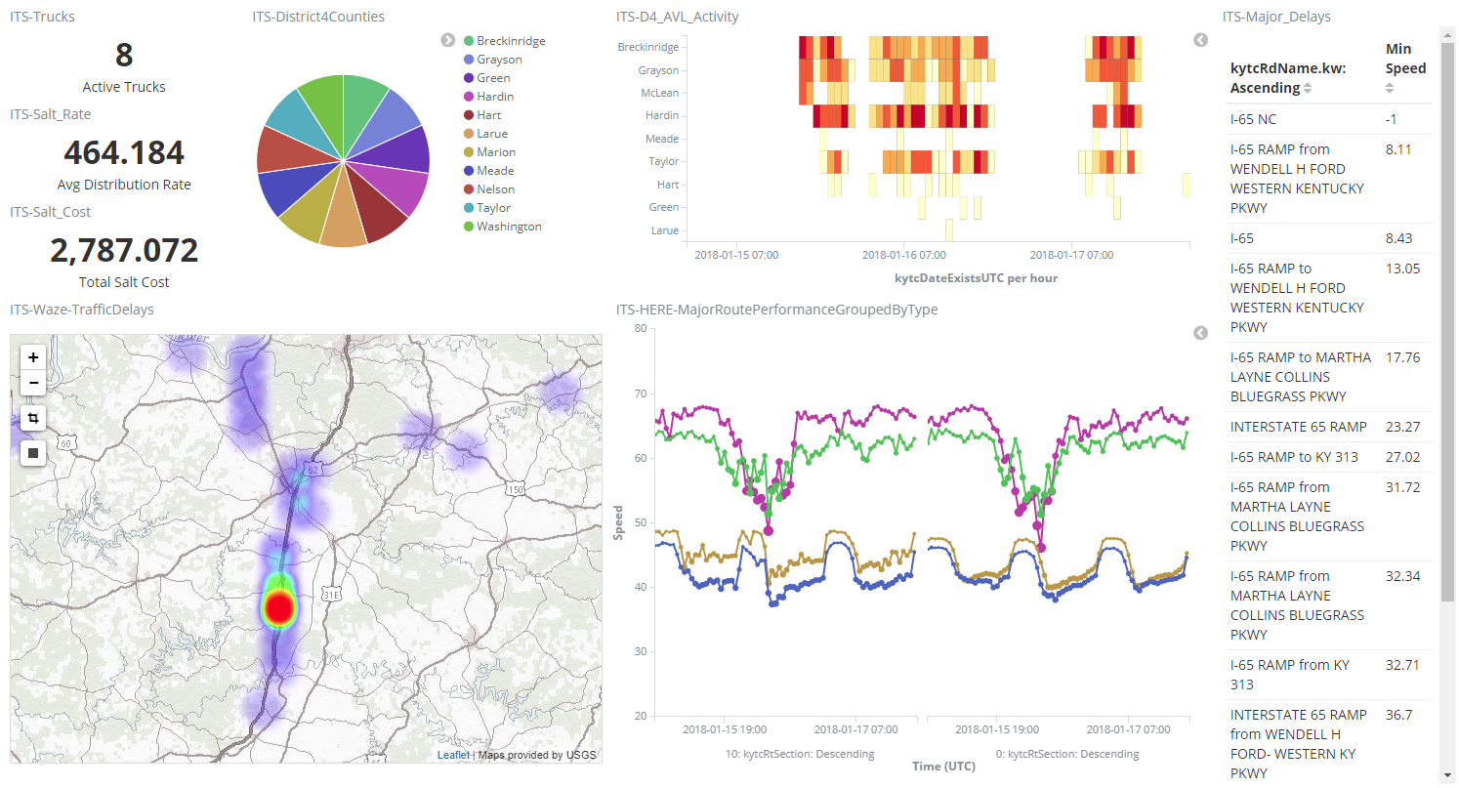

Slide 13
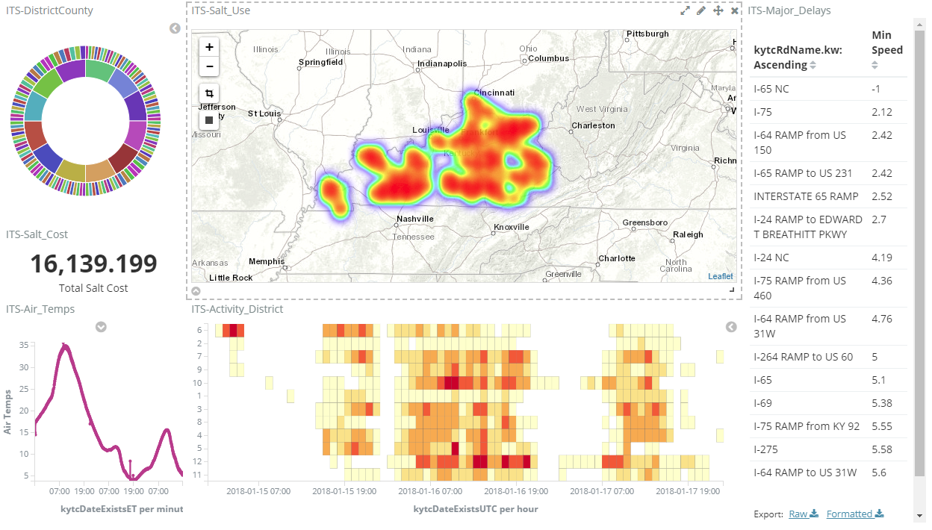

Slide 14
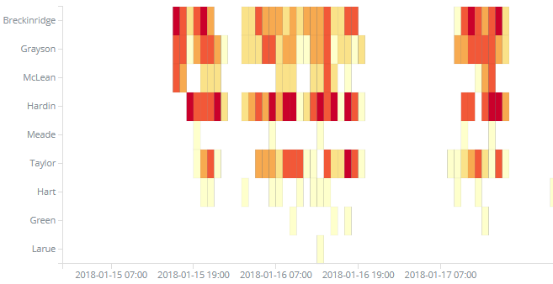
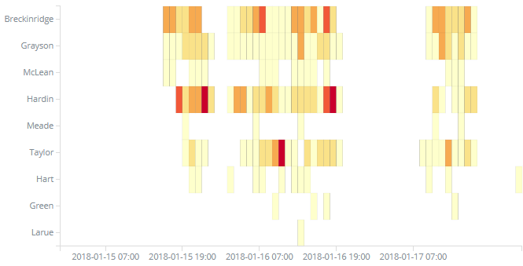
AVL Salt Distribution
AVL Activity

Slide 17
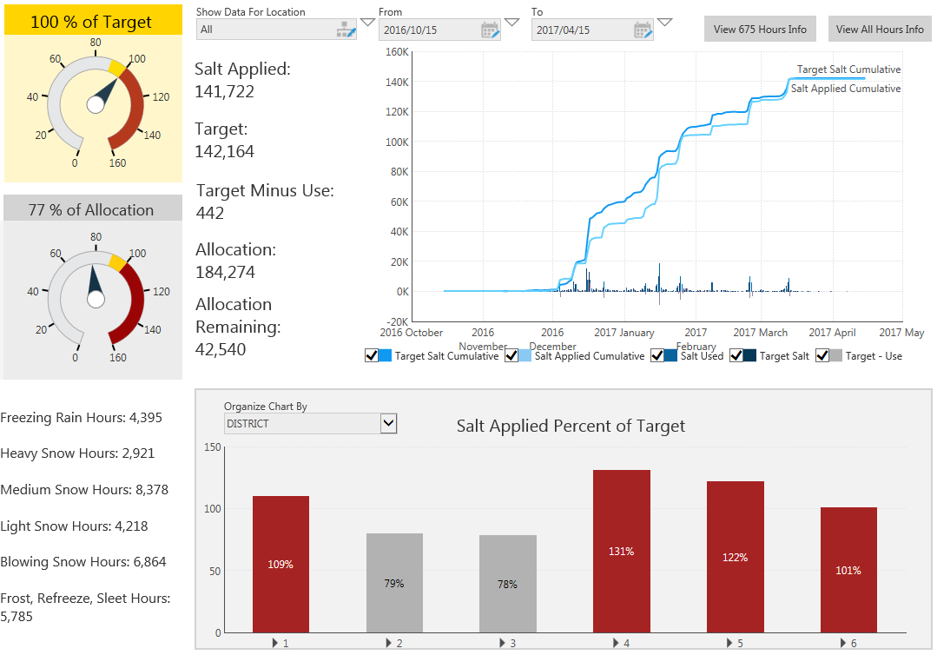

Slide 18
2007-2011
(pre dashboard) value of tons over estimated:
$1.6 M per year
2012-2017
(after dashboard) value of tons under estimated:
$1.9M per year

Slide 19
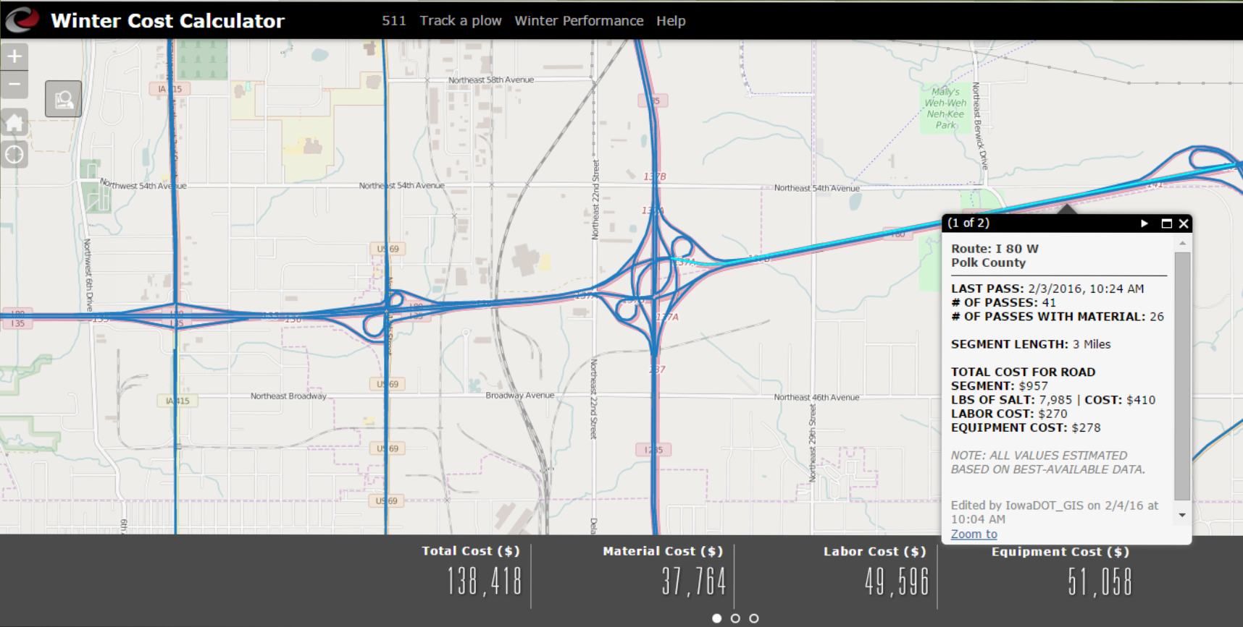
http://wintercostcalculator.iowadot.us

Slide 20
Work Zone Monitoring

Slide 21
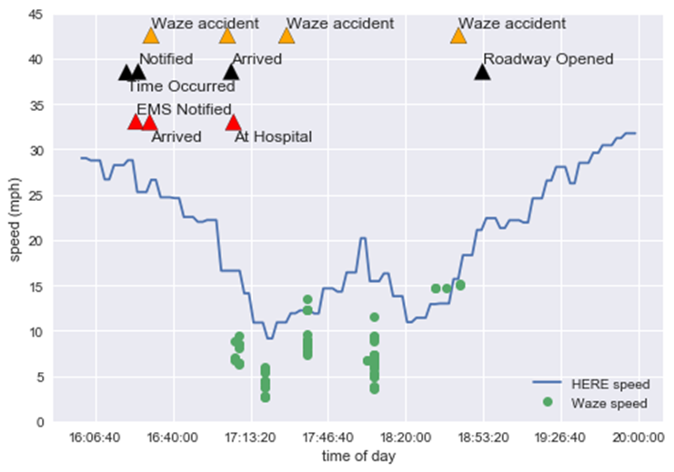
Fatal Crash
5/16/2016
at 16:20
Dixie Highway (US31W)
Mile point 12.146

Slide 22
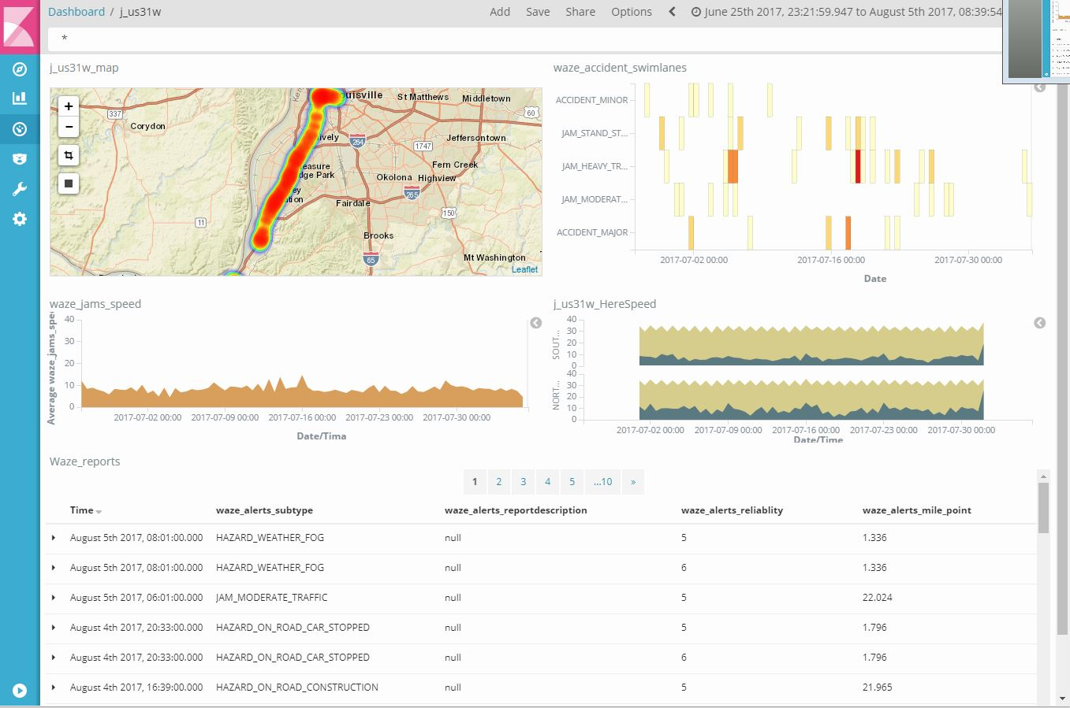

Slide 23
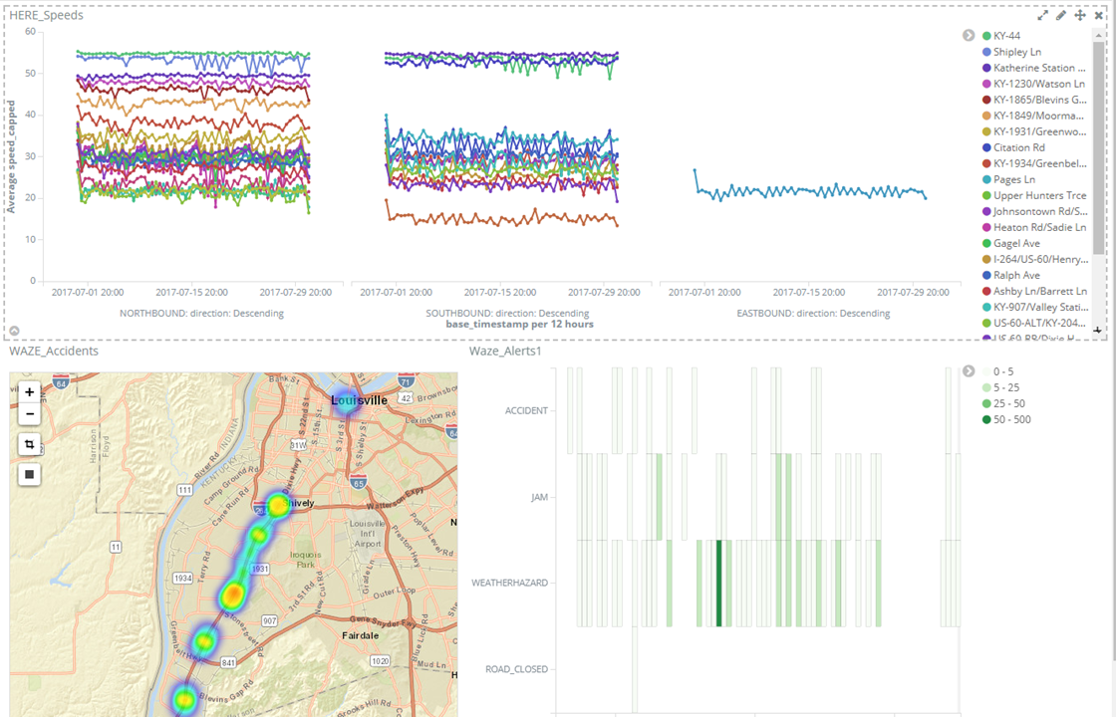

Slide 24
Questions

